Slide 1
VISUALIZING SAFE AREAS FOR PROSPECTIVE BUISNESS ESTABLISHMENT IN CHICAGO

Slide 2
Having knowledge of crime history of NEIGHBORHOODS is important to prospective Entrepreneurs
The success of a business relies heavily on the environment in which it is located.
Although there might be improvement or increase in crime-rate per time, the level of crime in the past years says a lot about the current and prospective scenario.
Having an understanding of the most prevalent crime can help prepare investors or enterprises on how to avoid being victims of such crimes.

Slide 3
DATA ACQUISITION AND CLEANING
Crime data were obtained from the Chicago city portal (https://data.cityofchicago.org/Public-Safety/Crimes-2001-to-present/ijzp-q8t2).
Latitude, Longitude, type of crime, location description and year of crime were scrapped from https://ibm.box.com/shared/static/svflyugsr9zbqy5bmowgswqemfpm1x7f.csv)
Rows containing null values in columns meant for coordinates were dropped.
Cleaned data contained 6 features

Slide 4
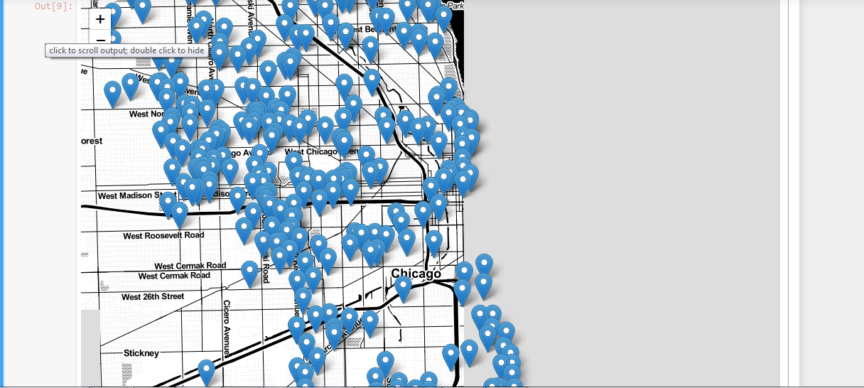
Chicago map with crime indications

Slide 5
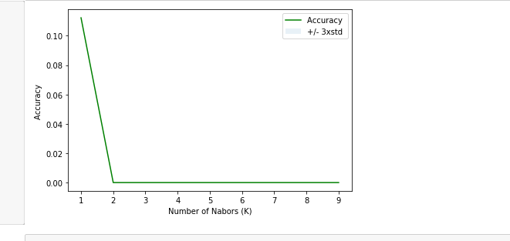
K Nearest Neighbors

Slide 6
CONCLUSION and FUTURE DIRECTIONS
Crime interference with business is expected to reduce as location moves closer to the west side of the city.
Model accuracy has a lot of room for improvement
Data visualization should be automated on regular basis for trends that migh be very important.

